Slide 1
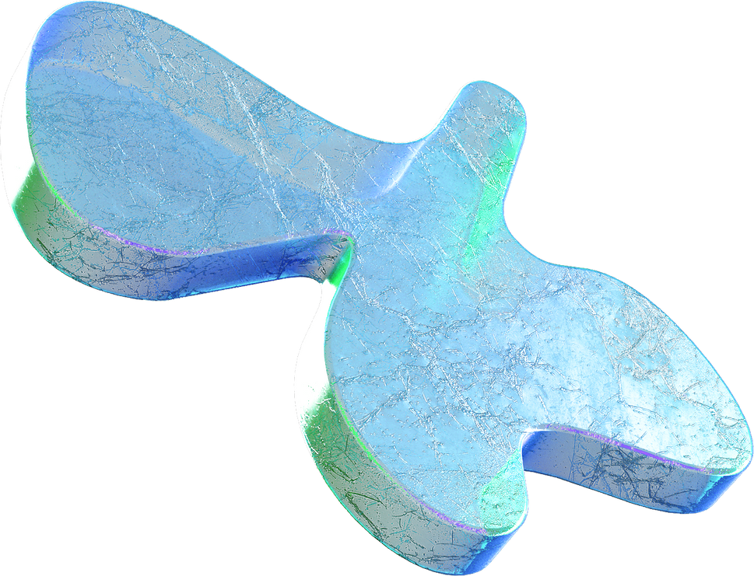
GUI BASED OS
Muhammad Shaheer zaman (21A-003-SE)
Muahmmad Anas Kamran (19B-123-SE)

Slide 2
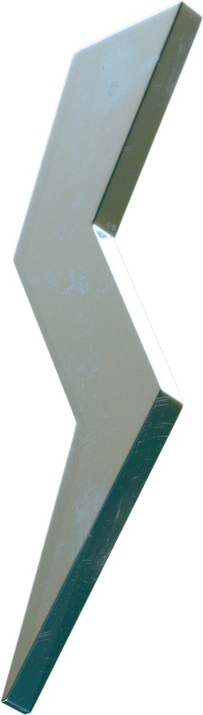
Table of
Content
What is operating system?
Project Description
Project Demosntration
Conclusion

Slide 3
Operating System
Core software that manages computer hardware and software resources.
Manages resource allocation, including CPU, memory, storage, and devices.
Handles process and task management, scheduling, and communication between processes
Provides a user interface for users to interact with the system and execute commands or launch applications.

Slide 4
Project Description
The "GUI-Based Operating System Shell using Zenity" is a project that aims to create a graphical user interface (GUI) for an operating system shell using the Zenity library in Bash scripting. The project provides a user-friendly interface with various functionalities typically found in an operating system.
Main Features
Main menu
File Management
File Explorer
Text Editor
Process Management

Slide 5
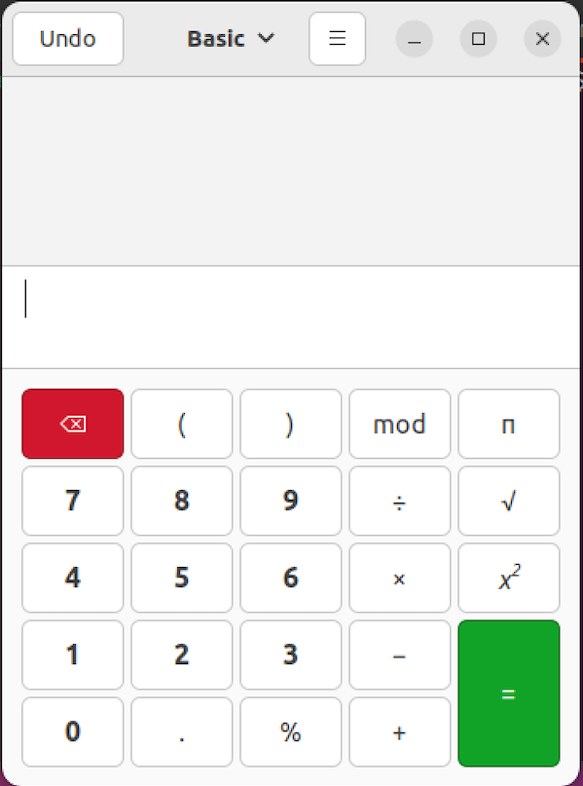
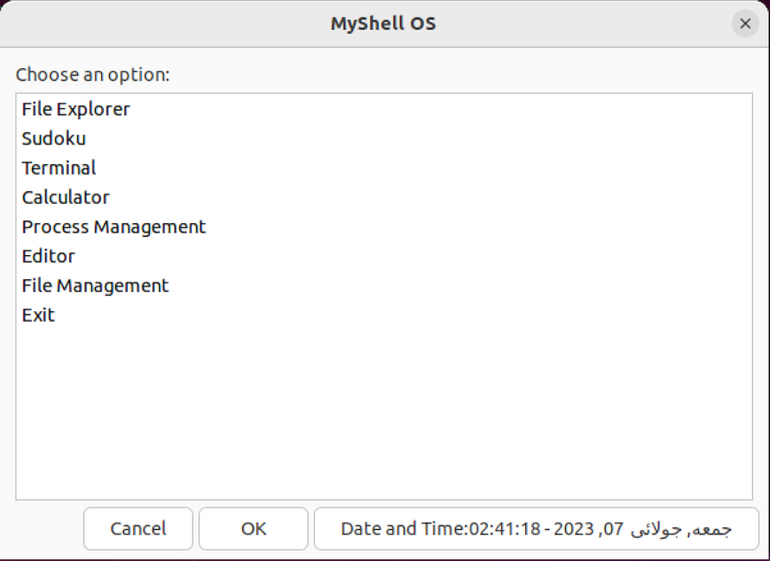
Demonstration
Calculator
Main Menu

Slide 6
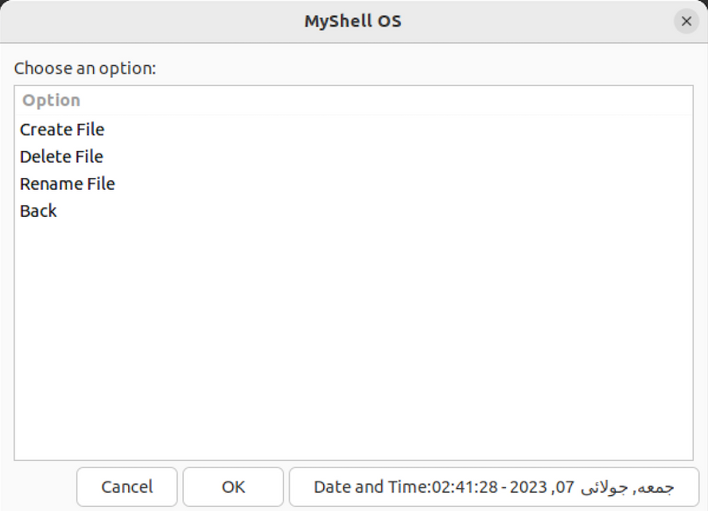
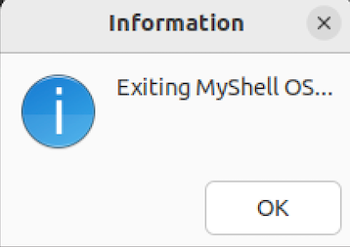
Demonstration
File Management
Dialog Boxex

Slide 7

Conclusion
By providing an intuitive GUI, the project enhances user interaction and simplifies common tasks, improving the overall usability of the shell environment.

